Slide 1

Study Buddy
Amazon Industry Program
Pitch-In

Slide 2
Agenda
01
Our Team
02
Why are we here?
03
Product Managment
Introduction to the team members:
“The Solutioneers”
Identifying the Challenge
Understanding the Significance
Proposing the Solution
Aligning the Solution to the Challenge
Market Size
Market Growth
Business Model
Competitors
Added Value

Slide 3
Meet “The Solutioneers”
01
02
03
Maya Ali
Nael Haidar
Youri Klim
04
05
Haifa Al Ashkar
Nancy Fayad
3rd Year CCE Student
Worked on the technical aspect.
3rd Year CCE Student
Worked on the technical aspect.
3rd Year CCE Student
Worked on the technical aspect.
3rd Year CCE Student
Worked on the technical aspect.
2nd Year Mech Student
Worked on the Product management.
We would also like to thank our mentor, Miss Nidhi Shah

Slide 4
Problem
College students often struggle to maintain focus and motivation when studying, leading to decreased productivity and academic performance. As students ourselves, we have experienced this problem and so have our peers as well.

Slide 5

Importance
Lacking motivation often leads to inadequate study habits, negatively impacting academic performance and understanding of the material. Notably, our project highlights the effectiveness of studying with a partner, emphasizing the significance of collaborative learning environments in enhancing motivation and learning outcomes.

Slide 6
Solution
Features:
User Authentication
Search bar and filters (major, compatible time, professor's name).
Display major-related posts.
Create a post with course details, professor's name, description, knowledge level, and available time.
Request System
Security Measures
To address this problem, we created a website “Study Buddy” that pairs students to study together upon their request.

Slide 7
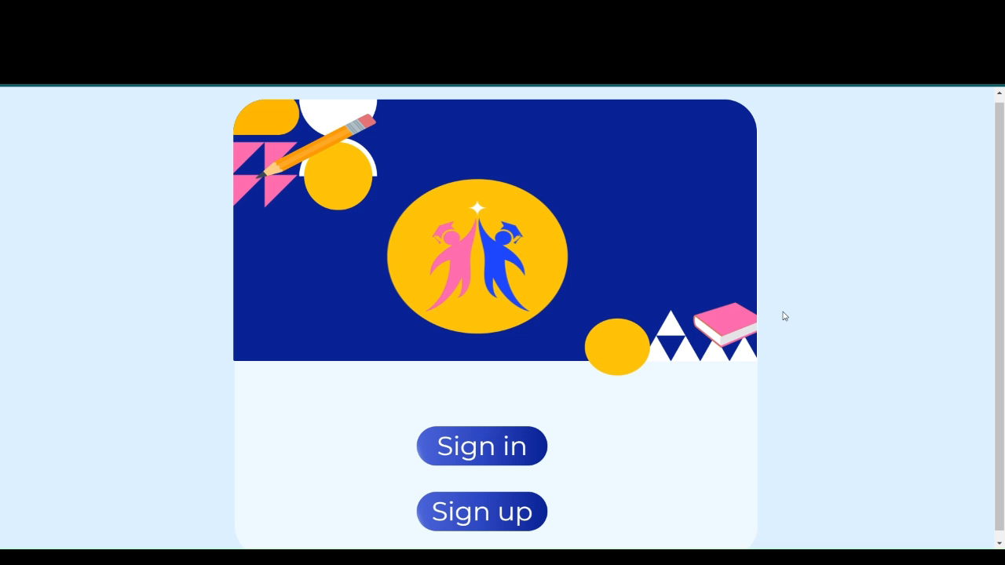

Slide 8
Target Costumer
Our target audience is college students, specifically AUB undergraduates. The website currently stores only undergrad AUB courses, which are made available for students to choose from upon creating a request.

Slide 9
Market Size
According to AUB facts and figures 2023, there are
approximately 6,000 enrolled undergraduate students, who are distributed between 6 faculties.

Slide 10

Market Growth
Approximately 1,041 masters and PhD students from AUB.
Can include another university too with a chance of 7,000 new consumers.

Slide 11
Competitors
Study Buddy
Tailored for AUB Students: Our platform is exclusively designed to meet the specific needs of AUB (American University of Beirut) students.
No Direct Competitors: Currently, there are no similar platforms that provide the level of customization and features tailored specifically to AUB students.

Slide 12


Added Value and benefit:
Education
Social assistance
Time efficiency
Cost-Free
Our website offers both educational and social support, making it a convenient and cost-effective solution for students, including those who may be hesitant to seek help from others.

Slide 13
80 hours
Costs
We developed our website using free platforms; however time is a very important factor that should be taken into consideration

Slide 14
Overview
Design Preparation: We've achieved a significant milestone by finalizing the design phase, establishing the web application's visual identity and user experience.
Front-end Development: We've executed successful front-end development, crafting all web pages using HTML and CSS. This effort ensures an aesthetically pleasing and user-friendly interface.
Backend Integration: Seamlessly connecting the front-end with the backend, we've harnessed the power of the Django framework to ensure robust functionality.
Database Integration: Our progress includes the effective integration of user input with a MySQL database, enabling the secure storage and retrieval of user data.

Slide 15
With your approval, we can:
Expand our website to grow our client base.
Maintain a high-level performance for
our website to satisfy all customers.

Slide 16
Thank you for your attention
Questions?

